Slide 1
course 2024 arnaud.nauwynck@gmail.com
this document: http://github.com/Arnaud-Nauwynck/Presentations/big-data/ 2-brief-history-distributed-computing
Brief History of Distributed Computing
Software/Hardware evolution, from Hadoop to Spark

Slide 2

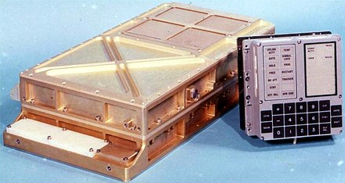
Big Data ...
Big? is Time-relative
cell phone (in 2021) >= 1000x "more"
than Appolo moon
guidance computer (1968)

Slide 3
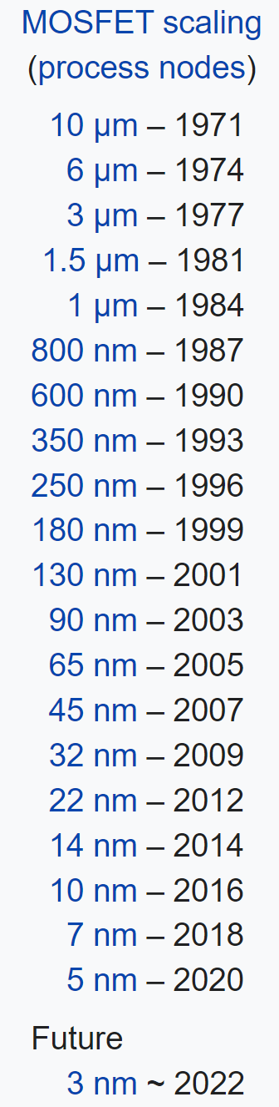
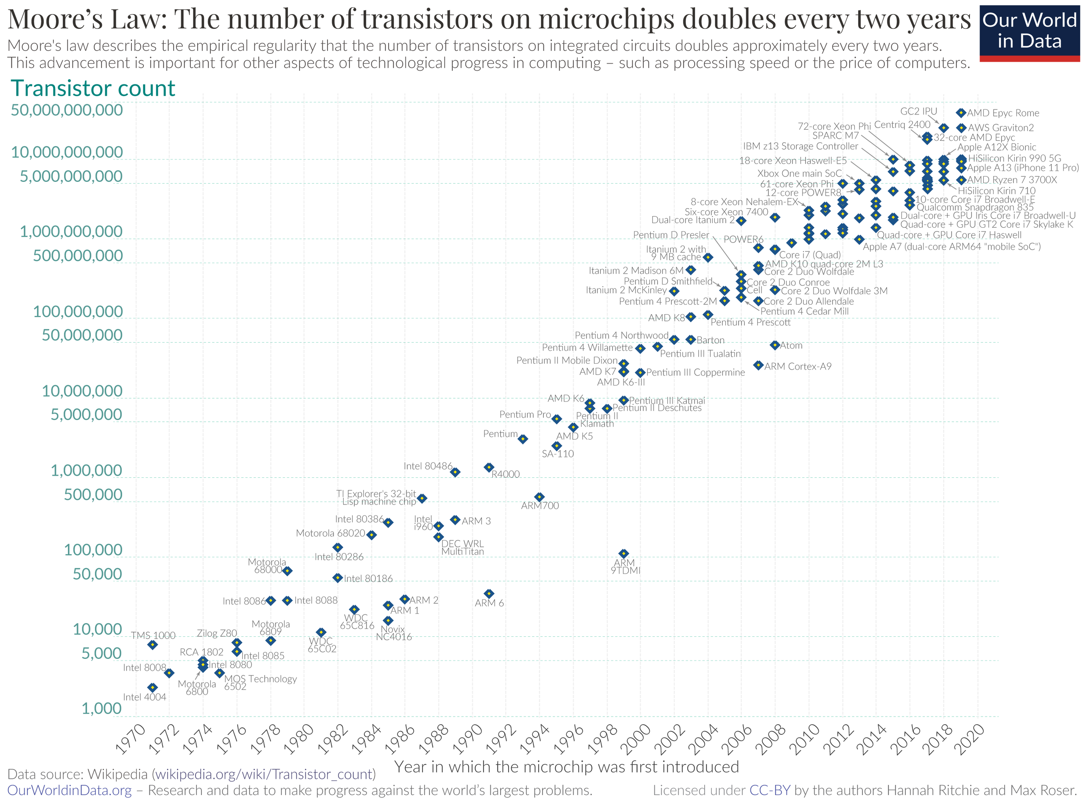
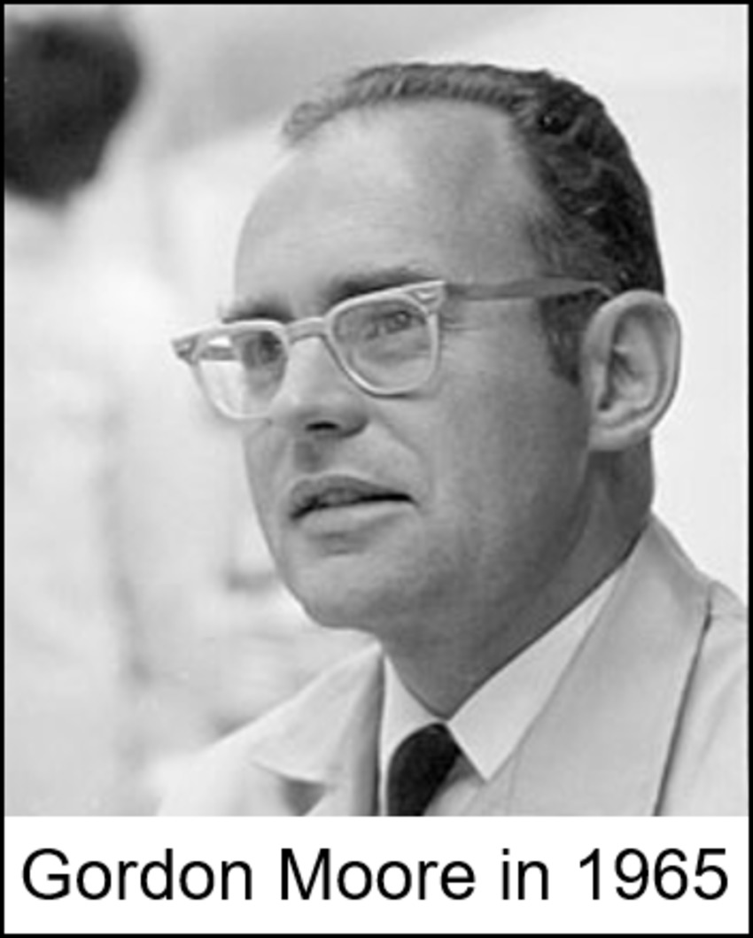
Moore’s Laws

Slide 4
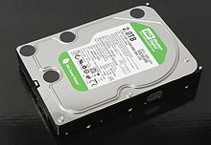
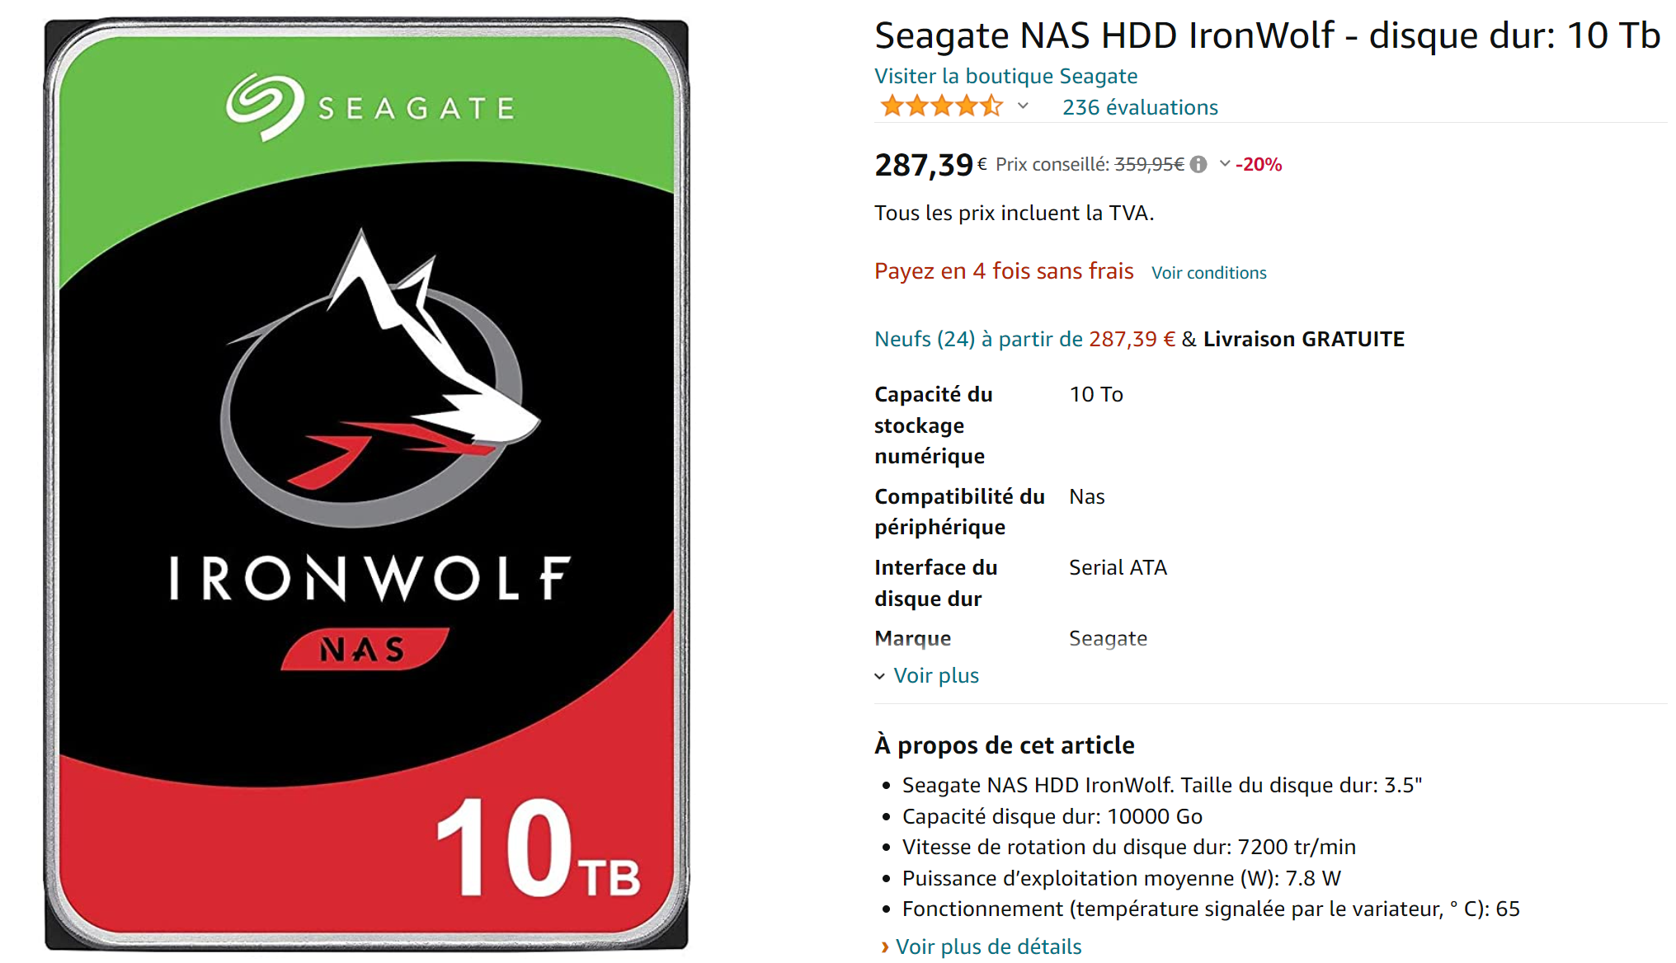
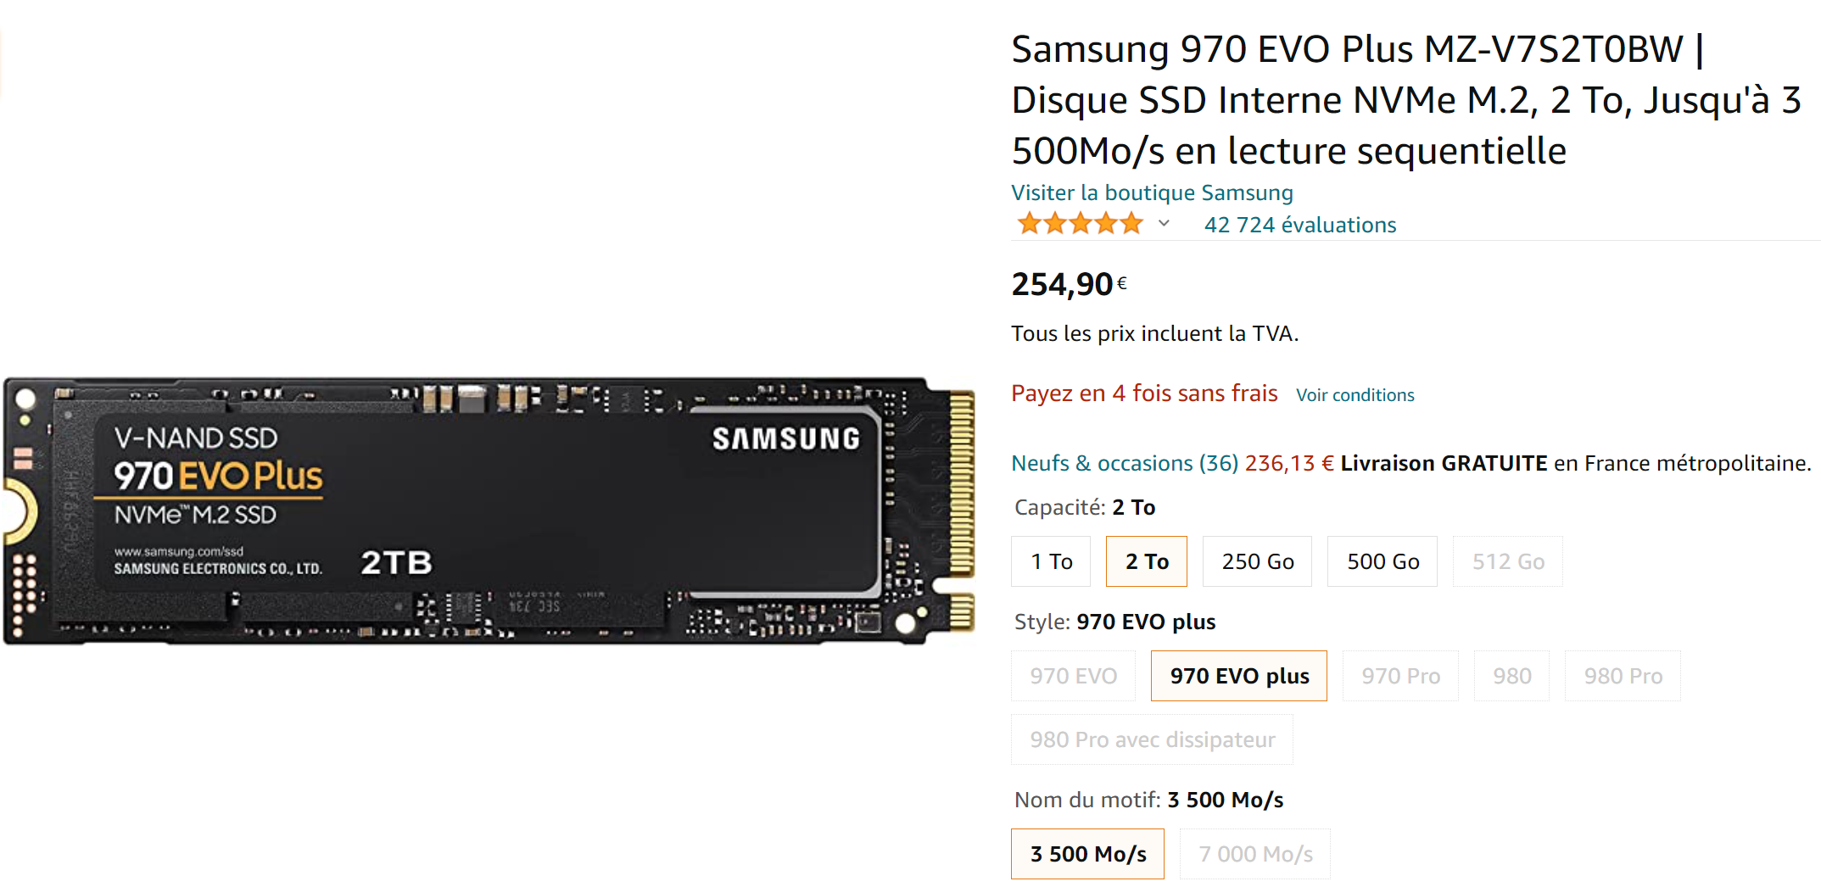
Kryder’s « Law »
density & capability of hard drive storage ~ *2 every 13 months
HDD: 2To in 2011
HDD: 10To in 2021 (~300 euros)
SSD: 2To in 2021 (~250 euros)

Slide 5
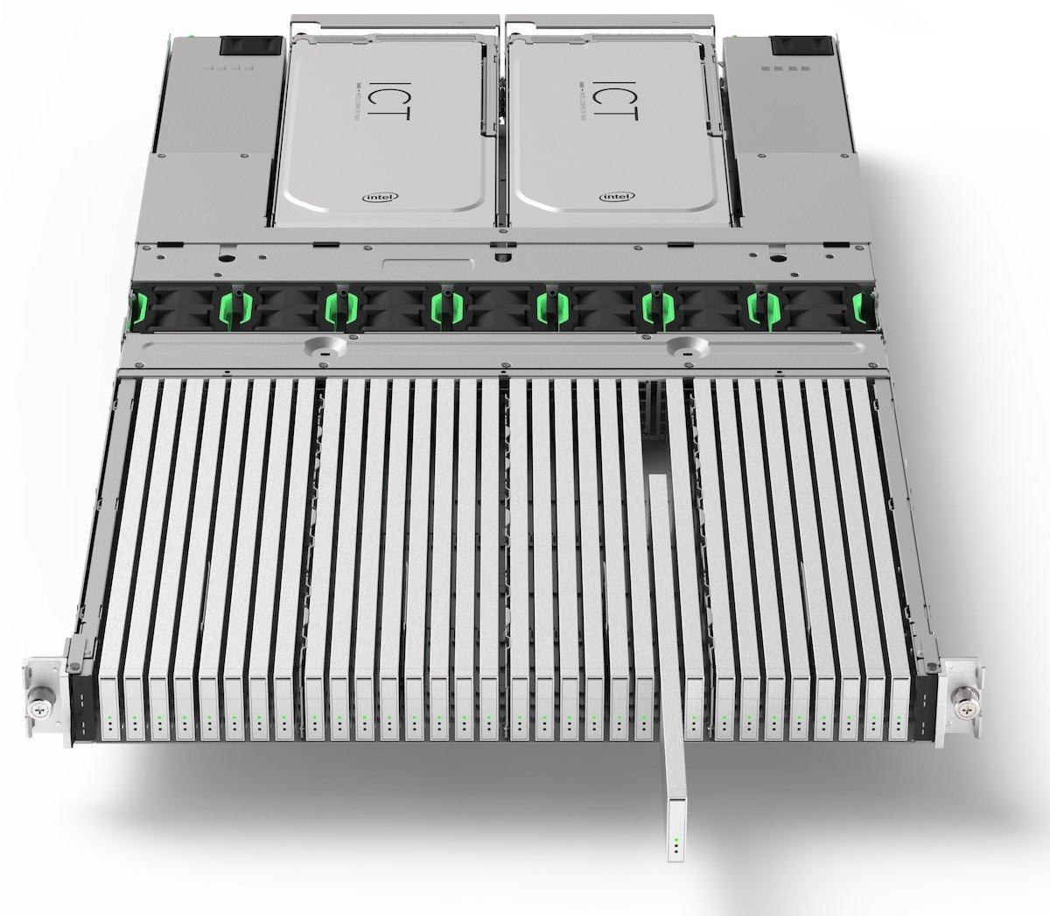
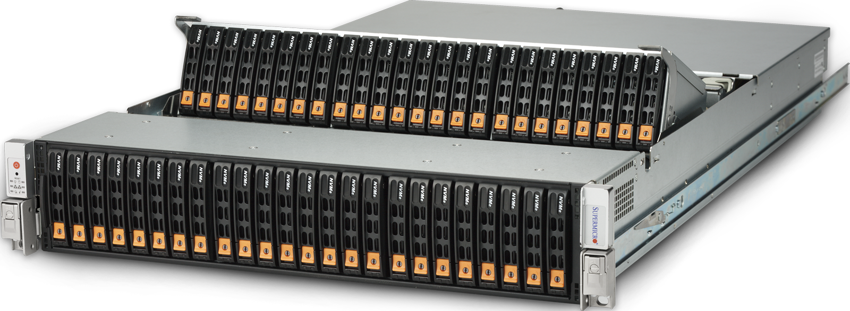
Density…
48 * HDD disks in 2U blade
32 * SSD (E.1 EDSFF) in 1U blade
… 500 Tera / 1 Peta !! … 200 000 euros

Slide 6
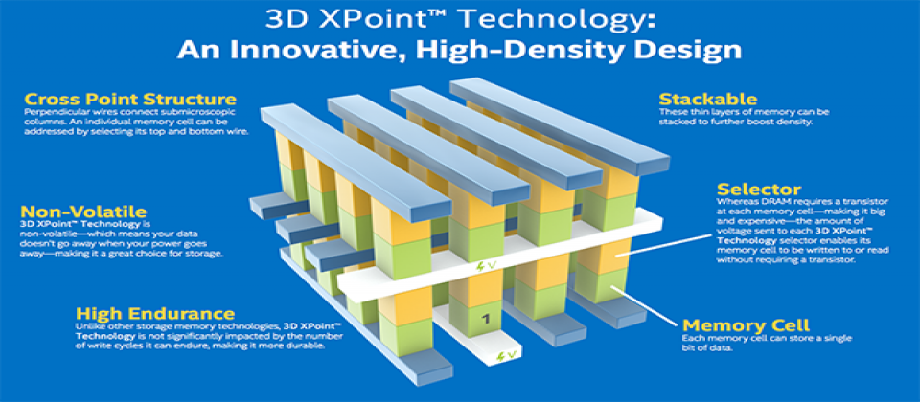
SCM: Storage Class Memory
persistent + fast
Compromise NDRAM <-> SSD

Slide 7
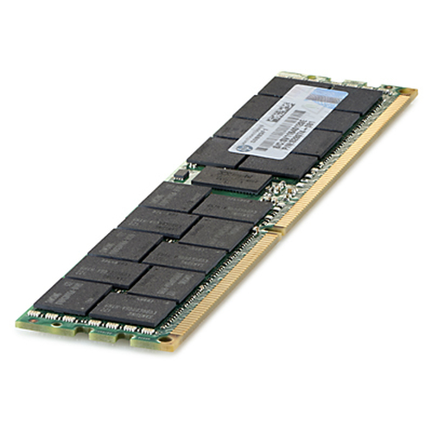
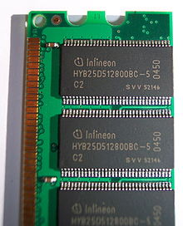
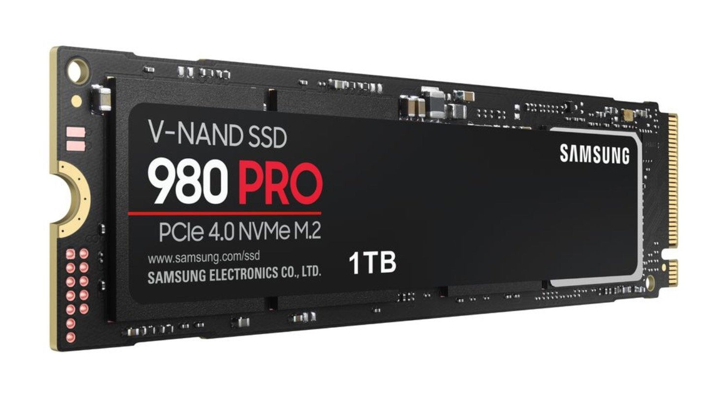
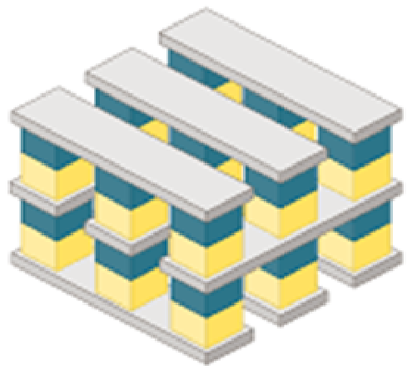

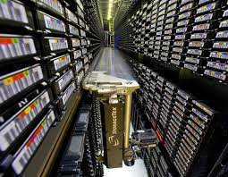
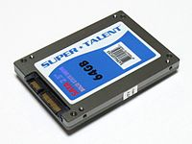
Memory & Disk Technologies Disruptions
future
switch??
RAM
~2015
Switch HDD / SSD
HDD
Tape
SSD (since 1991)
SCM - 3D Xpoint
(since 2017)
Next switch ??
> 2022

Slide 8
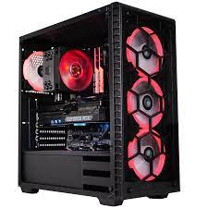
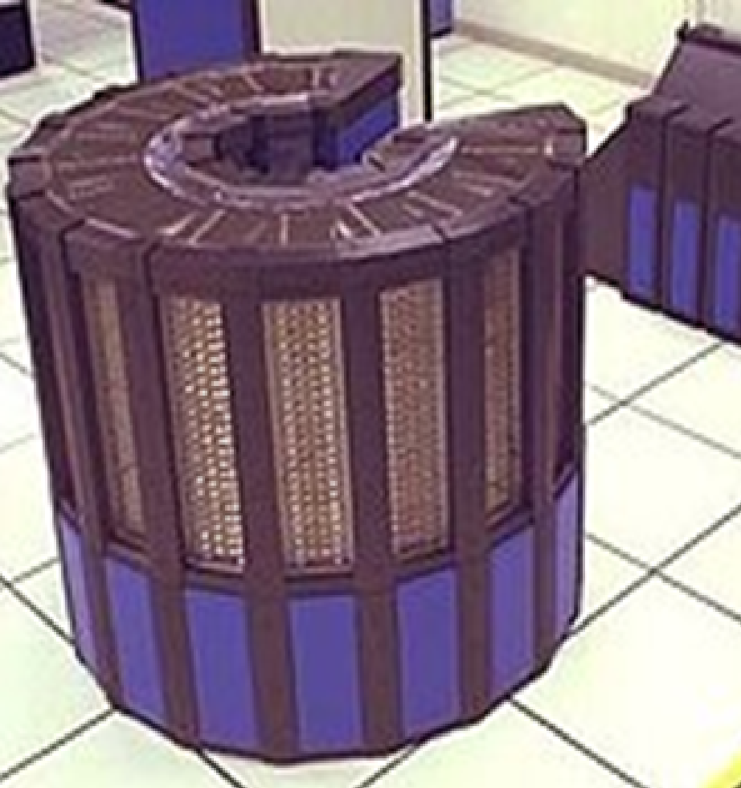
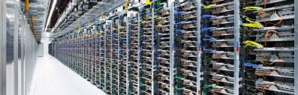
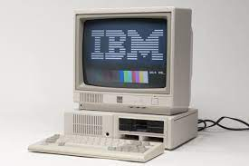
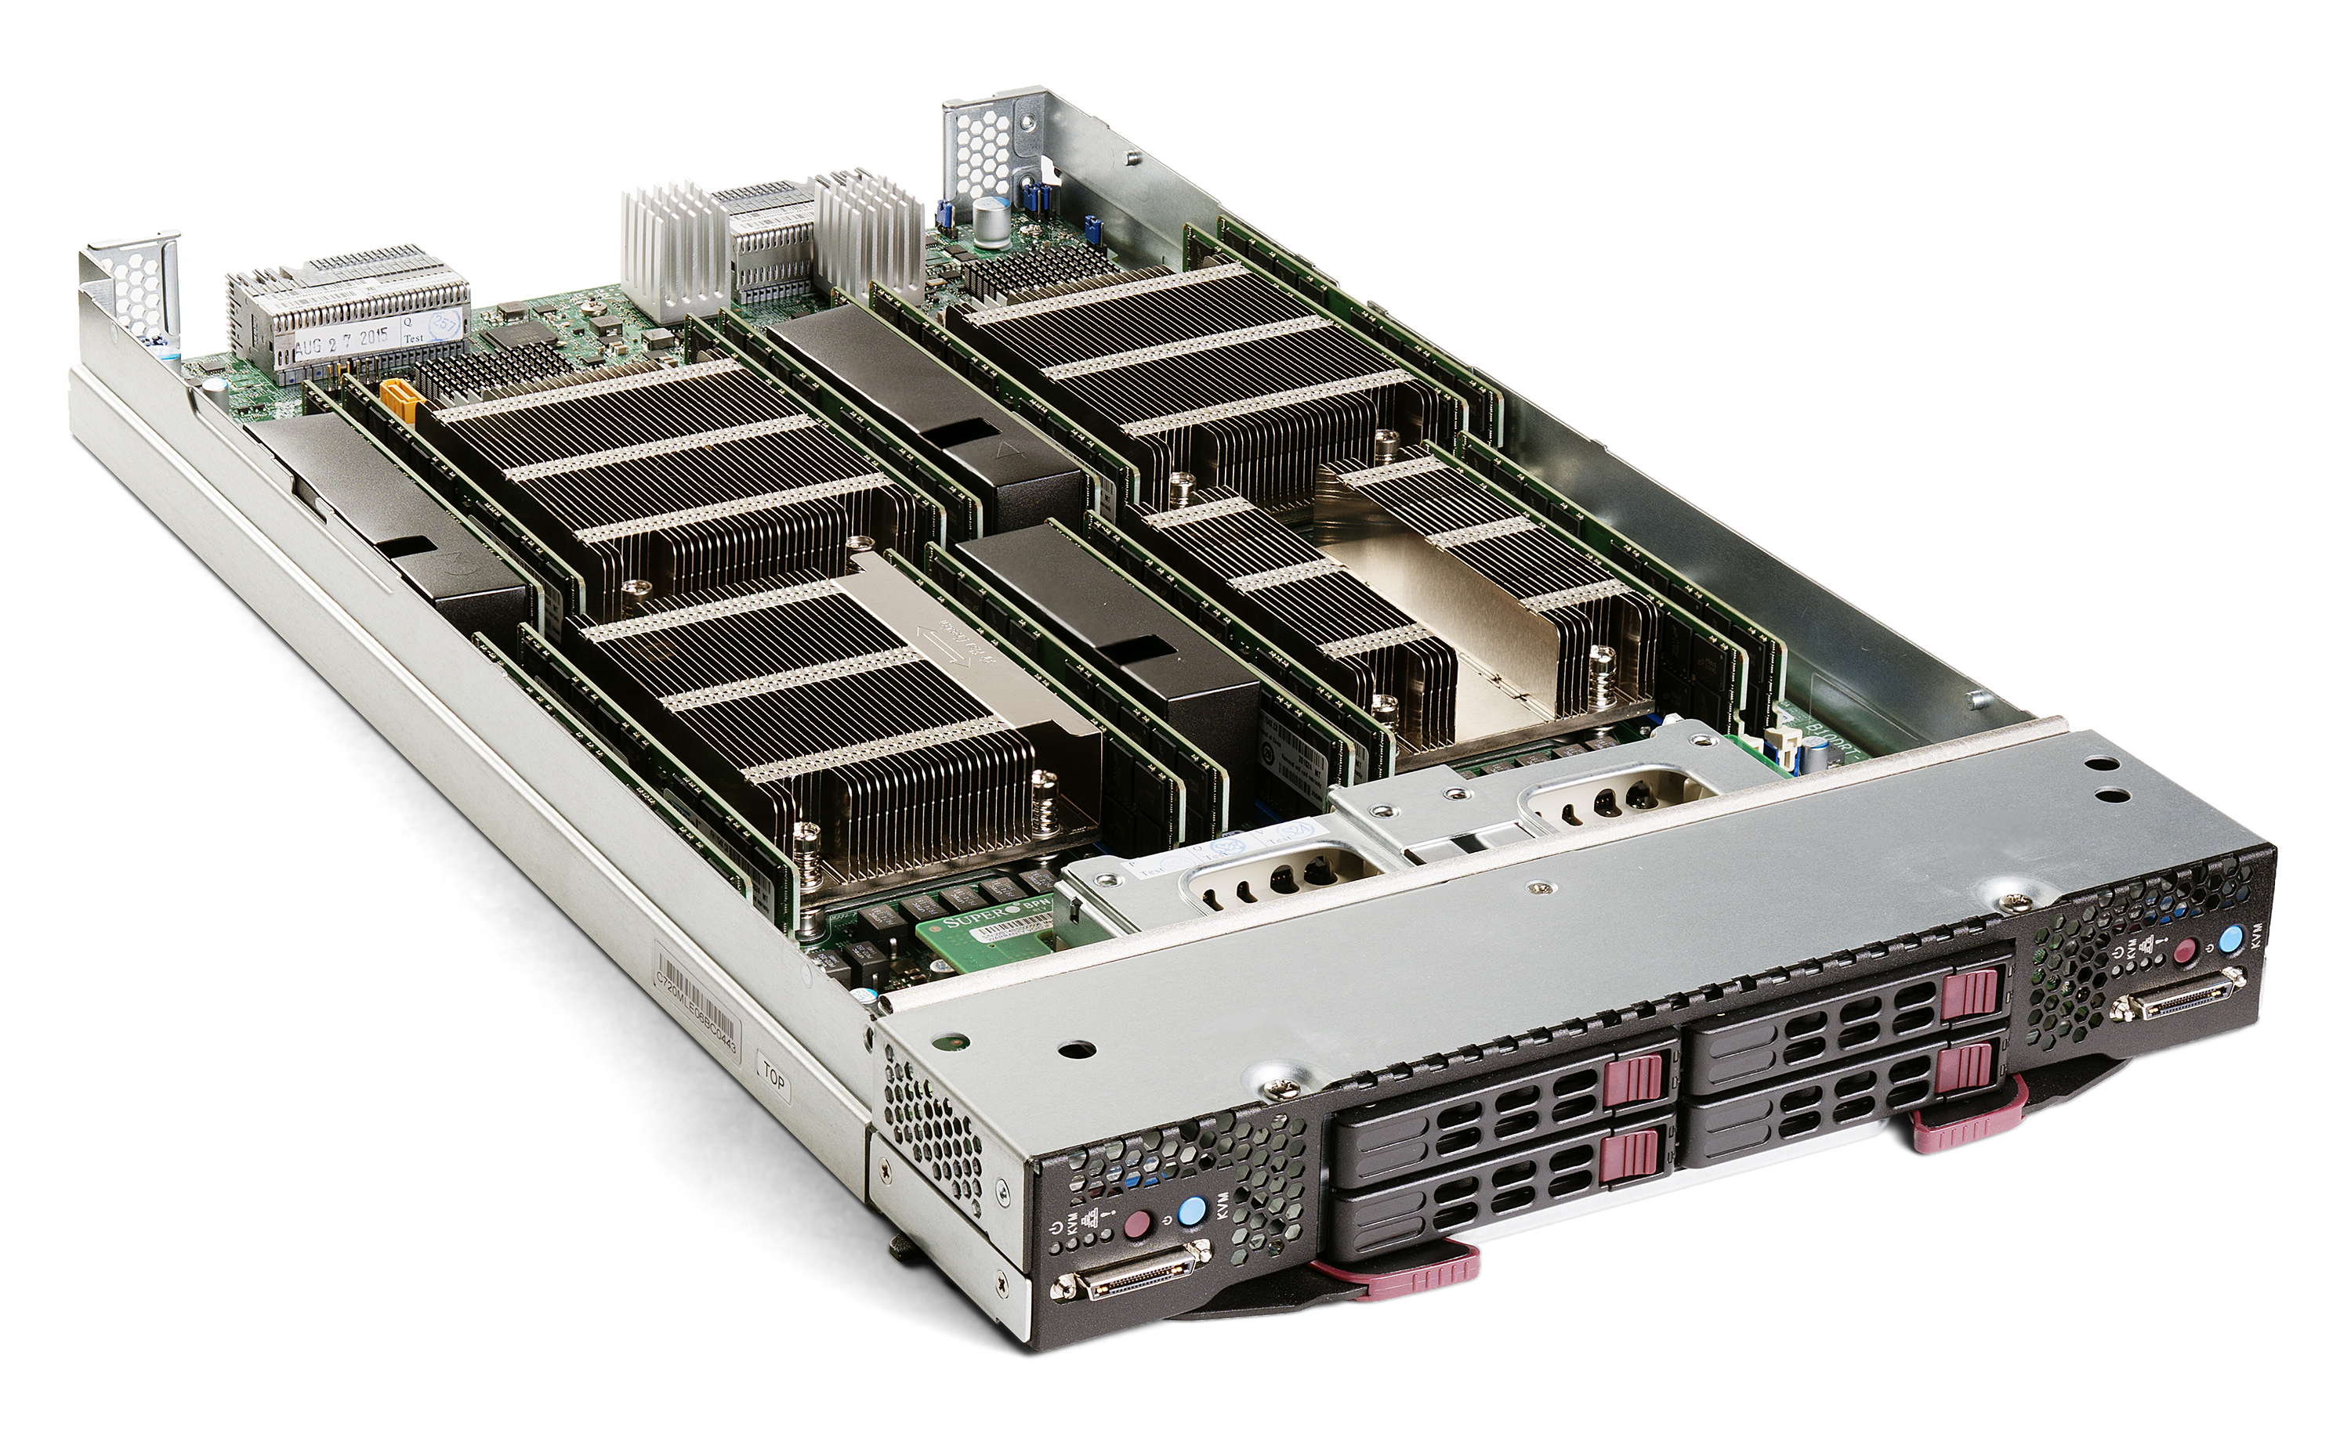
Vertical -> Horyzontal Scaling
Disruptions of DataCenters
Hardwares:
Distributed (DataCenters)
Hardwares:
Super-Computer
« Crays »
1980 : PC
« Blade » commodity hardwares

Slide 9
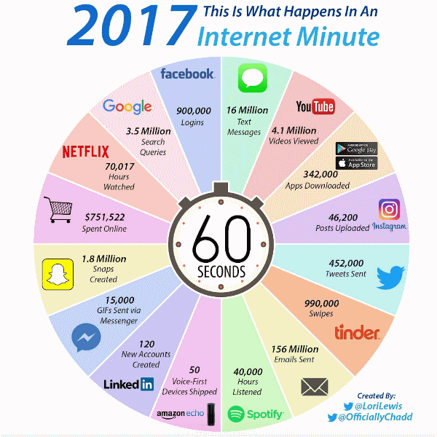
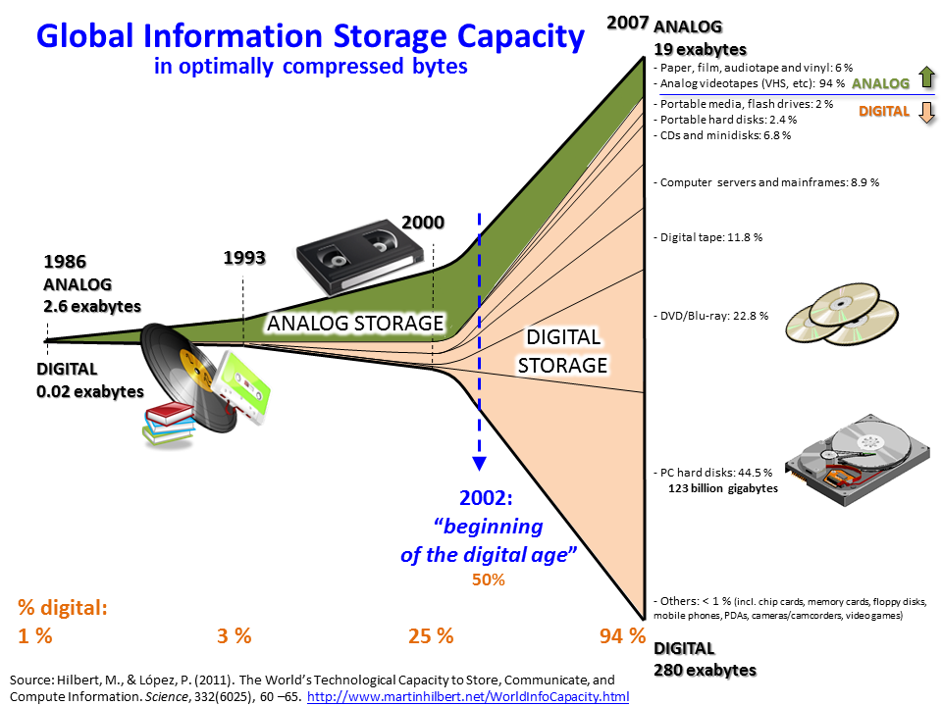
Data,Data,Data = DataCenters

Slide 10
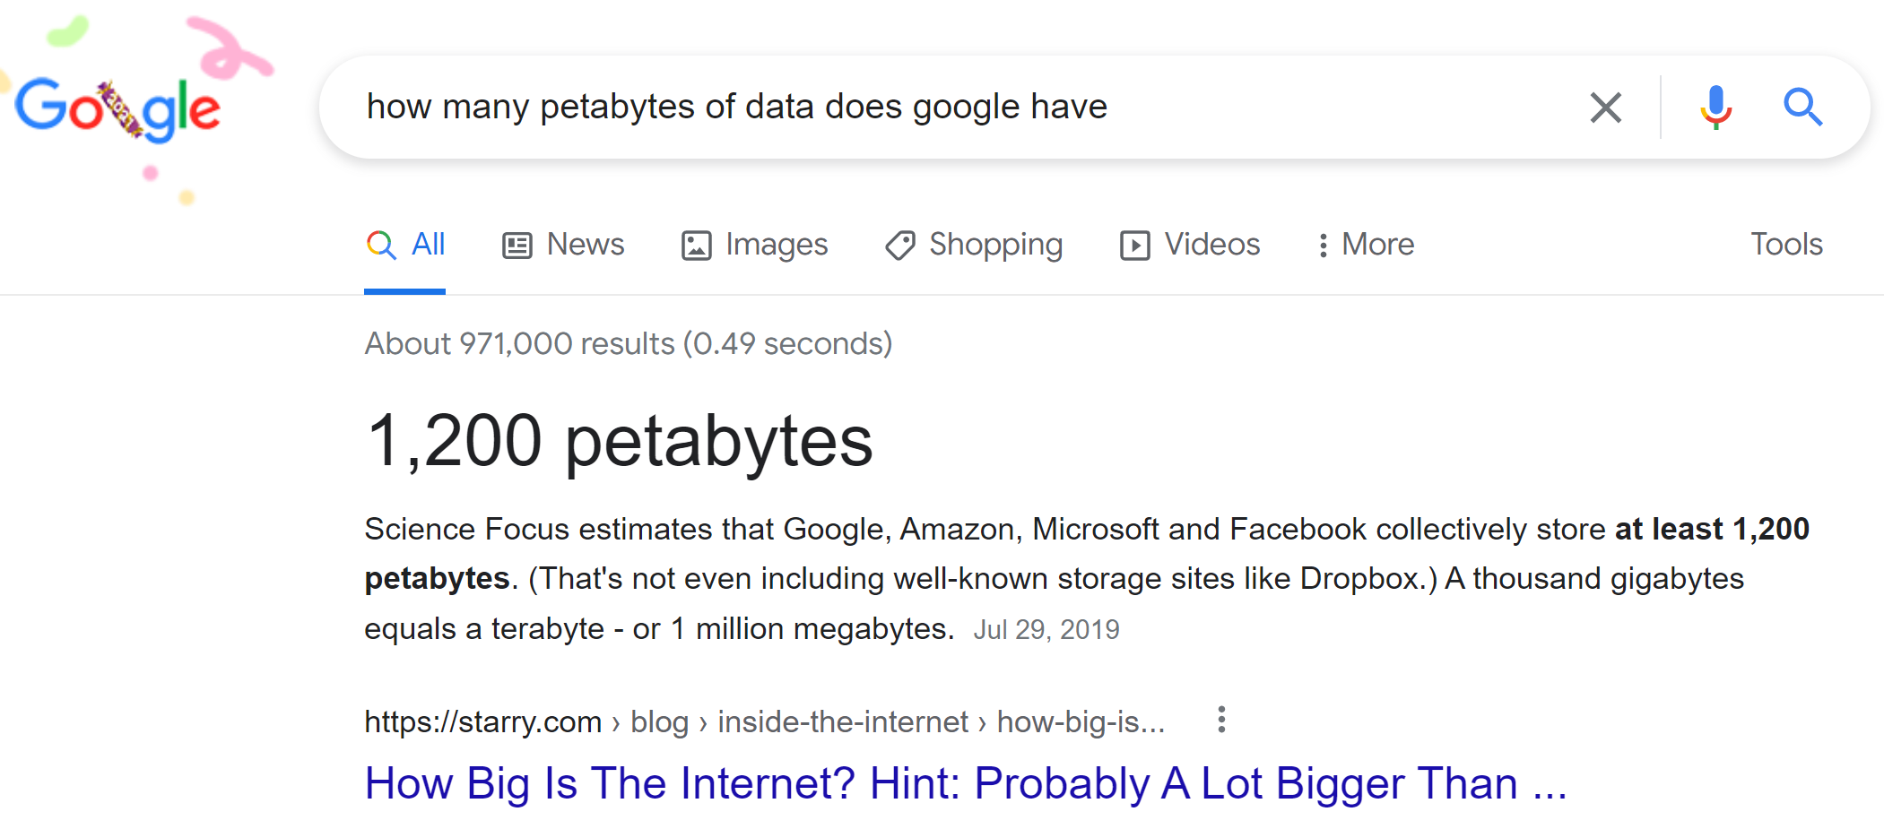

Slide 11
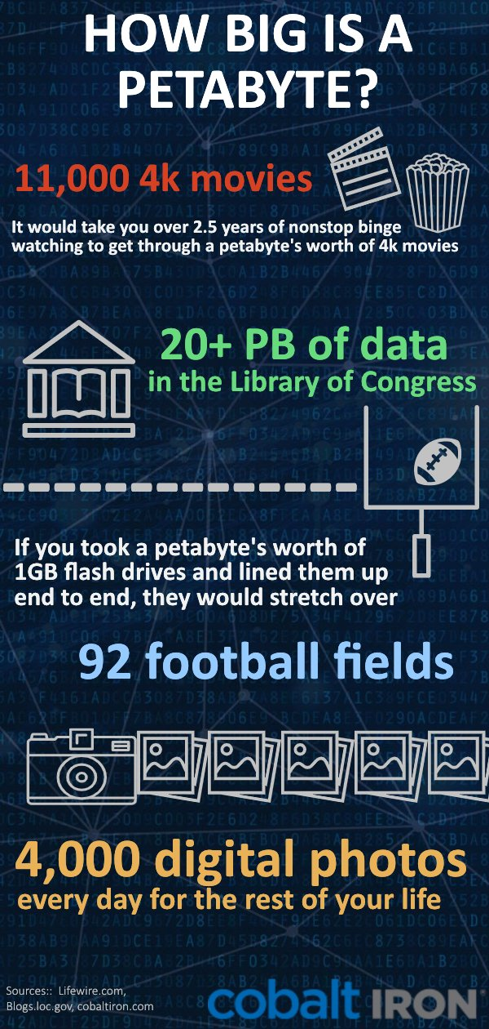

1 Peta = 1000 Teras
= 1,125,899,906,842,624 Bytes
Not Only for
Example at French Bank «SG » : 3 Petas in 2020
for storing Vars / Risks / market params / trades
« Small » Cluster : 6 racks
~ 90 servers * { 256 RAM + 42 cores + 8 disks }

Slide 12
Softwares for BigData ?
No more traditionnal
Oracle DB + single Jdbc client …

Slide 13
Definition of BigData
= NO FIT in a Single Server (even 10Million$, Huge with SAN)

Slide 14
3 Vs
Volume, Velocity, Variety
(5vs : + veracity, value )

Slide 15
3 Vs
Volume, Velocity, Variety
> Peta bytes
<= 1 h / day to process
>= Millions files
( Parquet..)

Slide 16
Softwares Disruption
Distributed & Fault Tolerance
Software: MPI
Message
Passing
Interface
(1 OS, 1 process, N Threads)
Software: MapReduce
Distributed computing
… Fault Tolerant
1995
2004

Slide 17
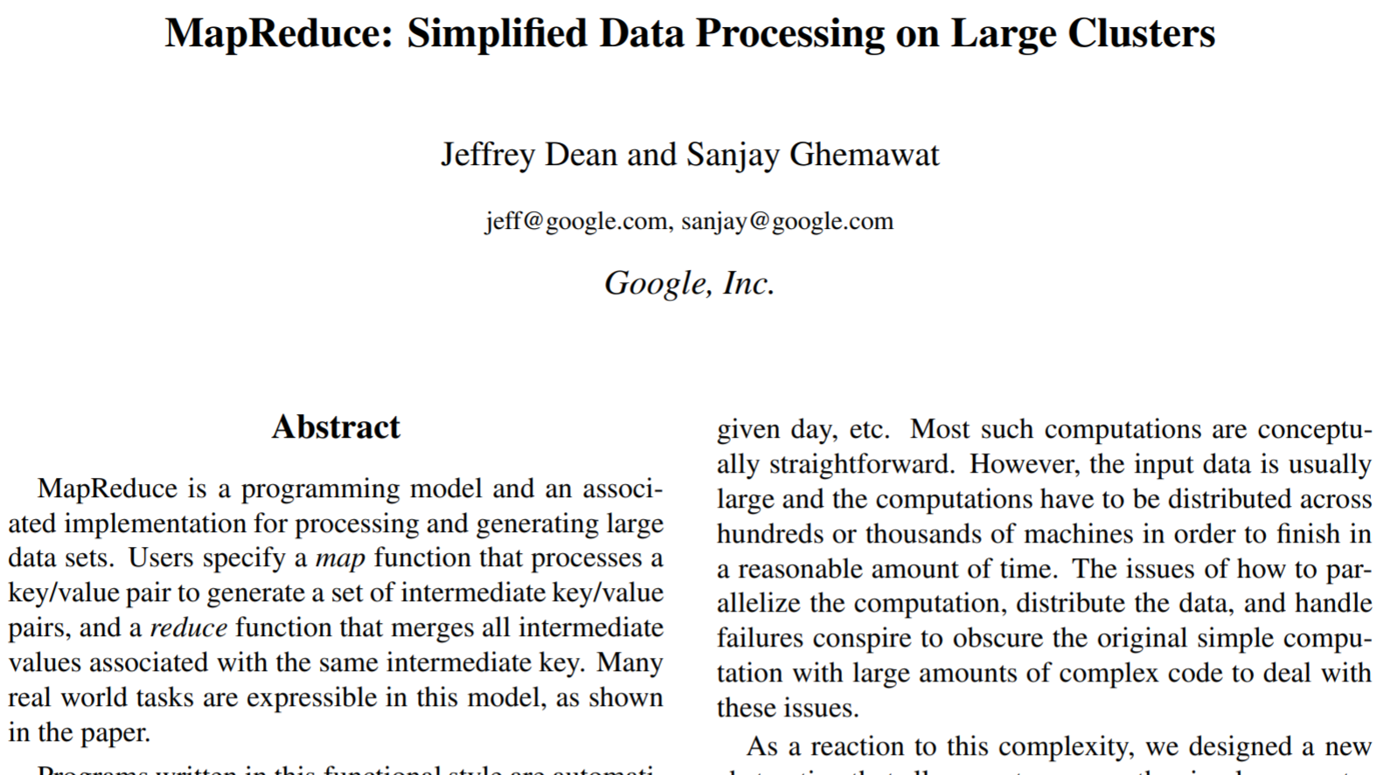
MapReduce Google paper : 2004
(end of use ~2014)

Slide 18

MapReduce @Yahoo = Hadoop .. 2006
Commodity Hardwares (datacenters):
Only HDD + RAM
Data Locality : co-host Storage near Compute
use RAM to cache
avoid network
Constraint
=>
Architecture
Choice
Think different?
2006
2020

Slide 19
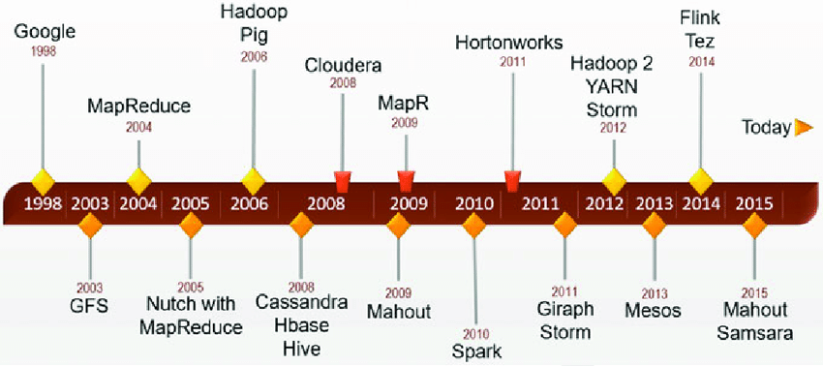
Hadoop + Community + Companies
+ Specific Tool 1 + Specific Tool 2+ …

Slide 20
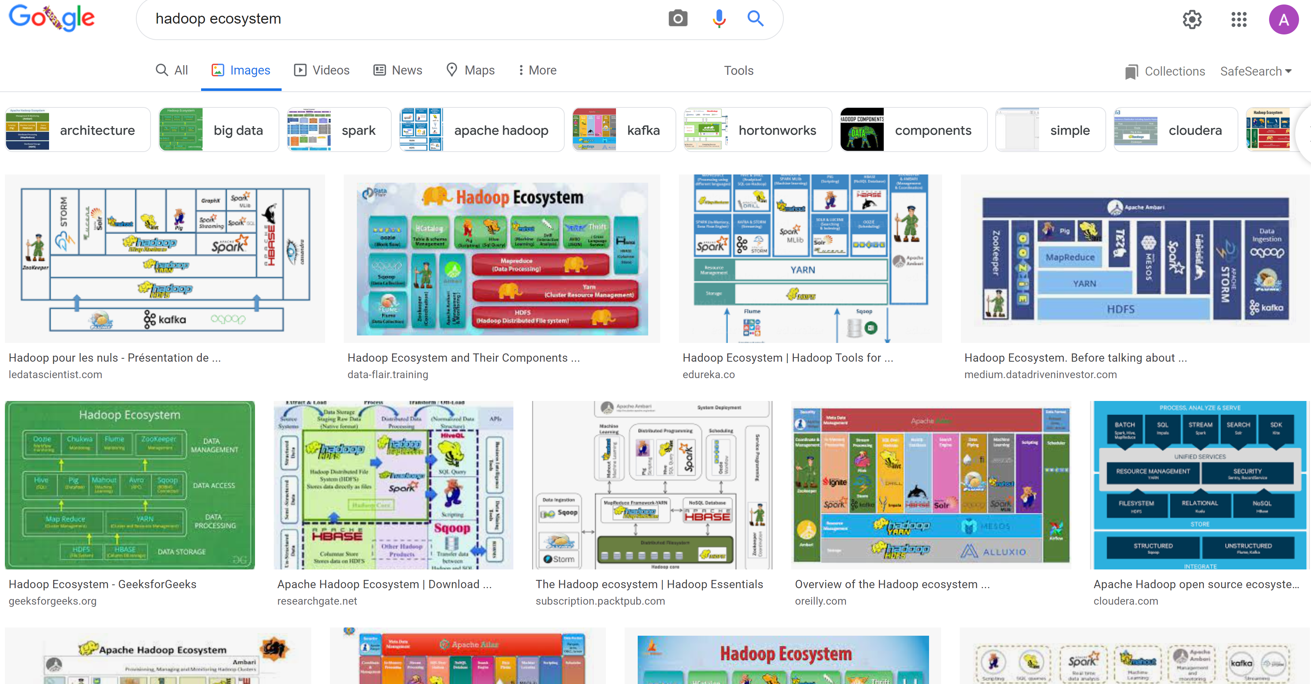
Hadoop Ecosystem « Explosion »

Slide 21

At The end, Only 1 will remain
( French TV Game: Koh-Lanta)

Slide 22


Slide 23
Spark Spark Sql / Mlib / .. Spark Streaming
1 System
N library extensions
2 Modes (Batch / Streaming)

Slide 24
